Slide 1
網站安全分析

Slide 2
設定DVWA

Slide 3
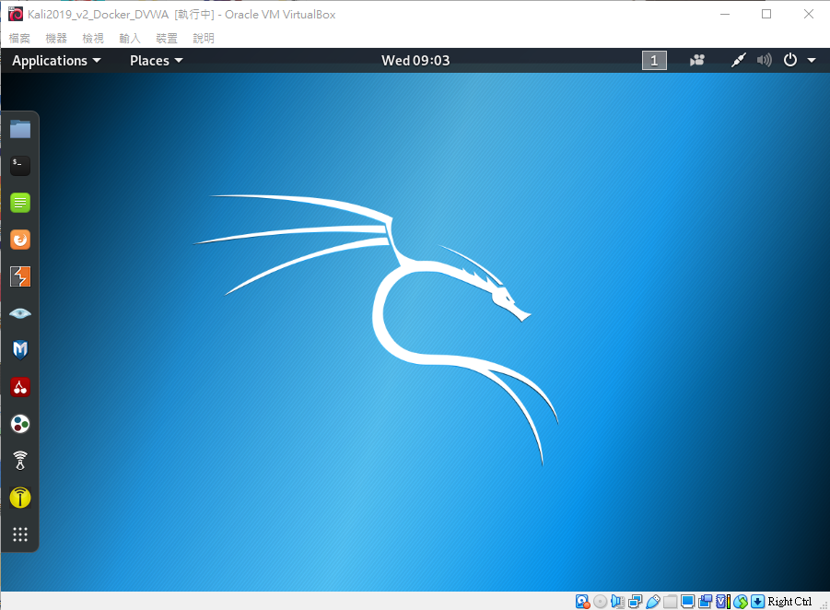
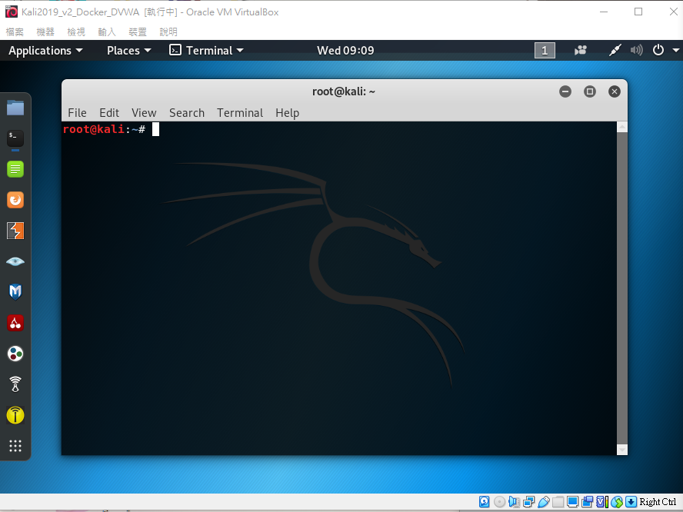
登入kail linux

Slide 4
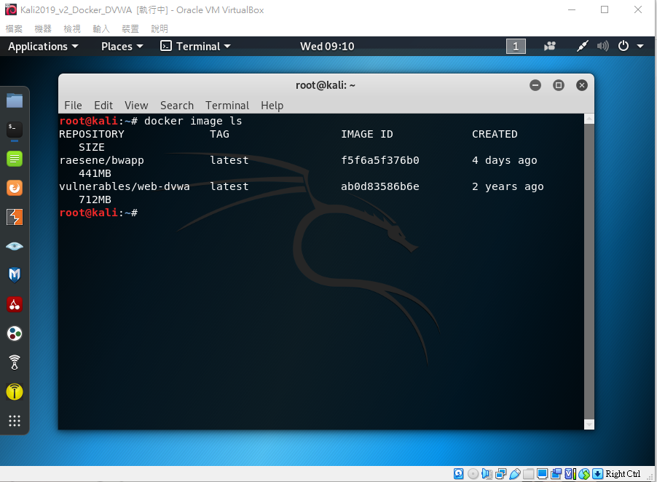
檢視現有 dockr image
docker image ls

Slide 5
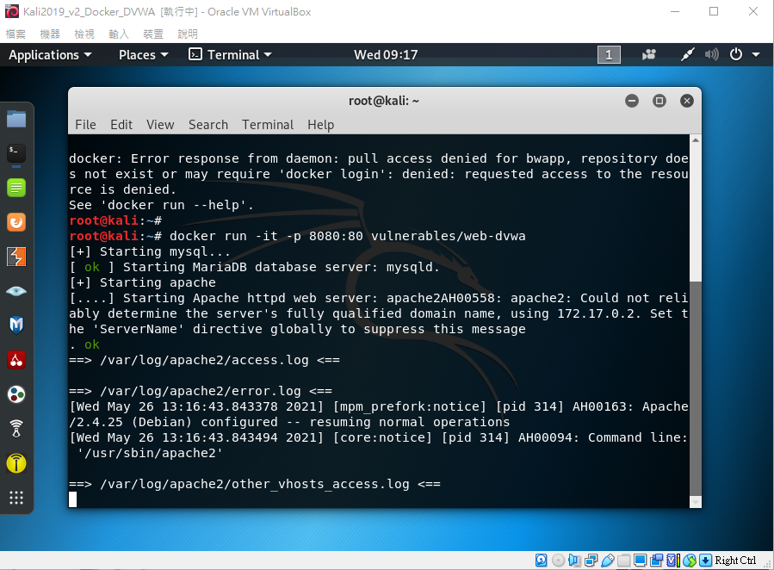
執行DVWA
docker run –it –p 8080:80 vulnerables/web-dvwa

Slide 6
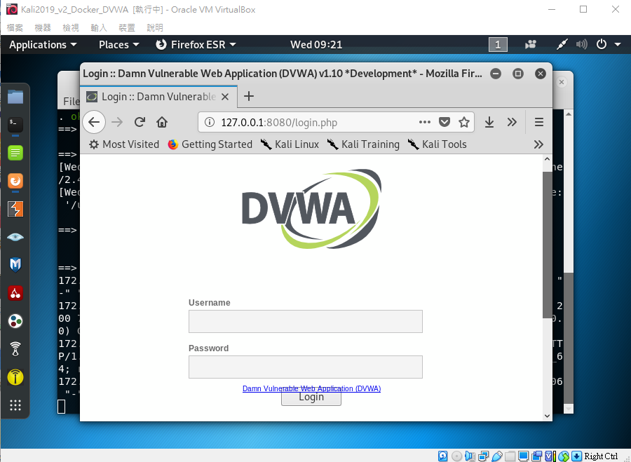
瀏覽器 admin /password
http://127.0.0.1:8080/login.php

Slide 7
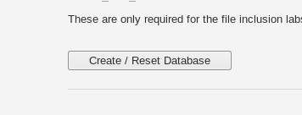
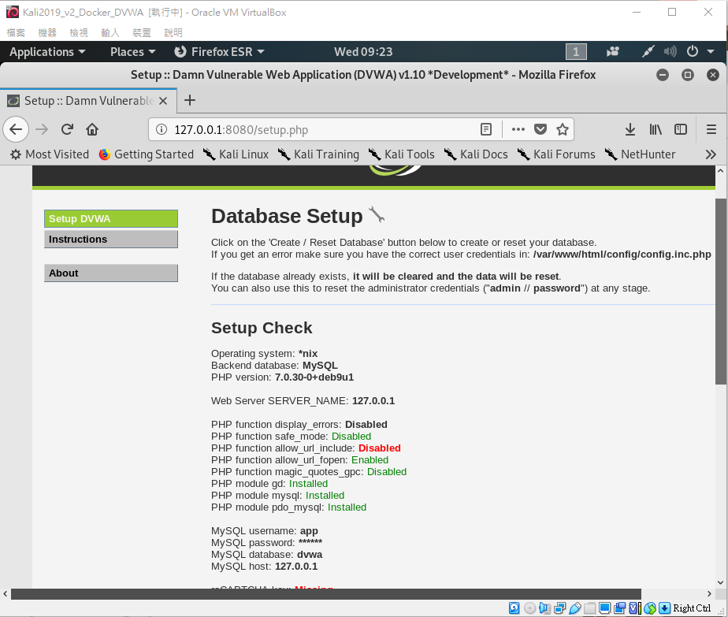
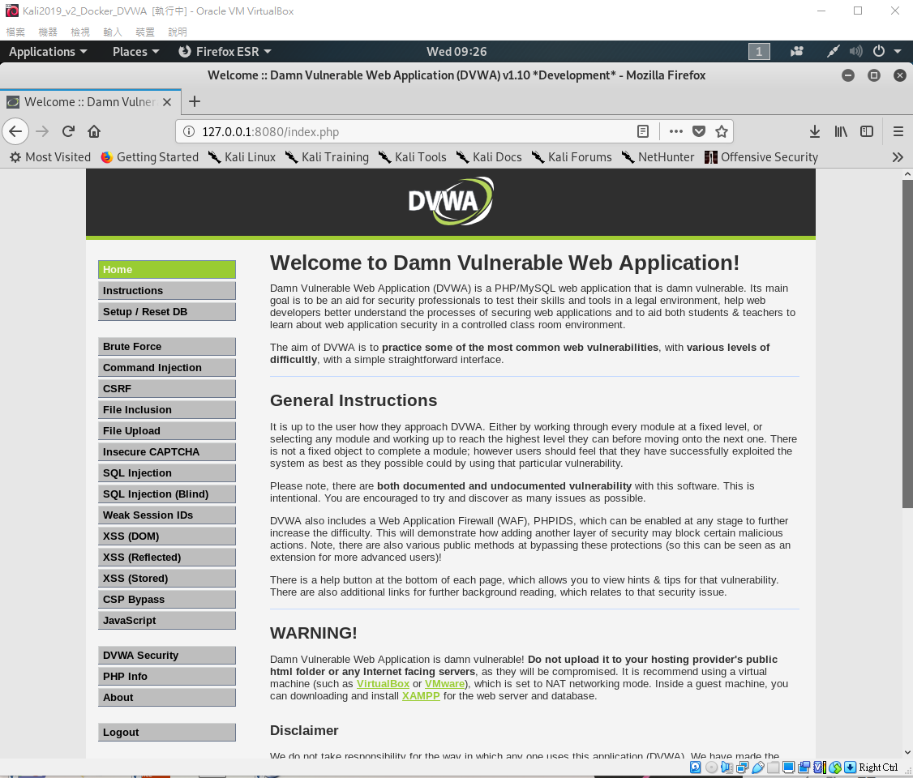
設定DVWA

Slide 8
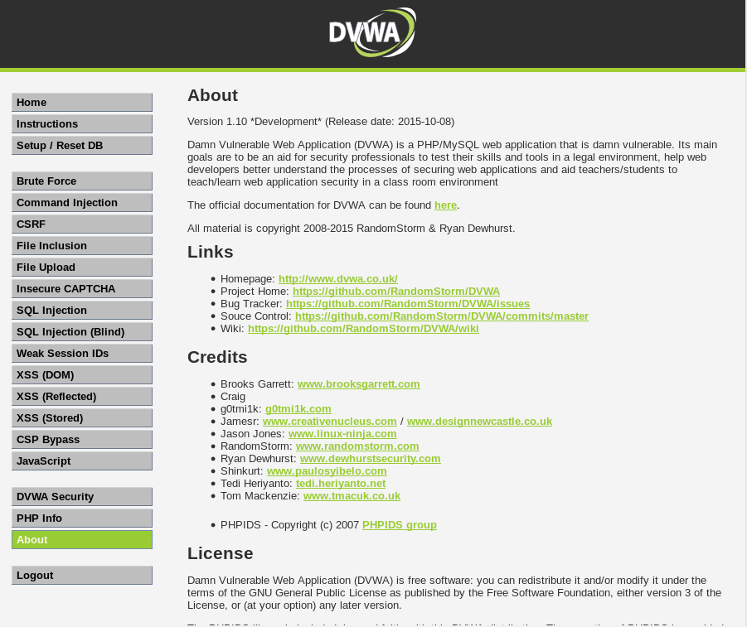
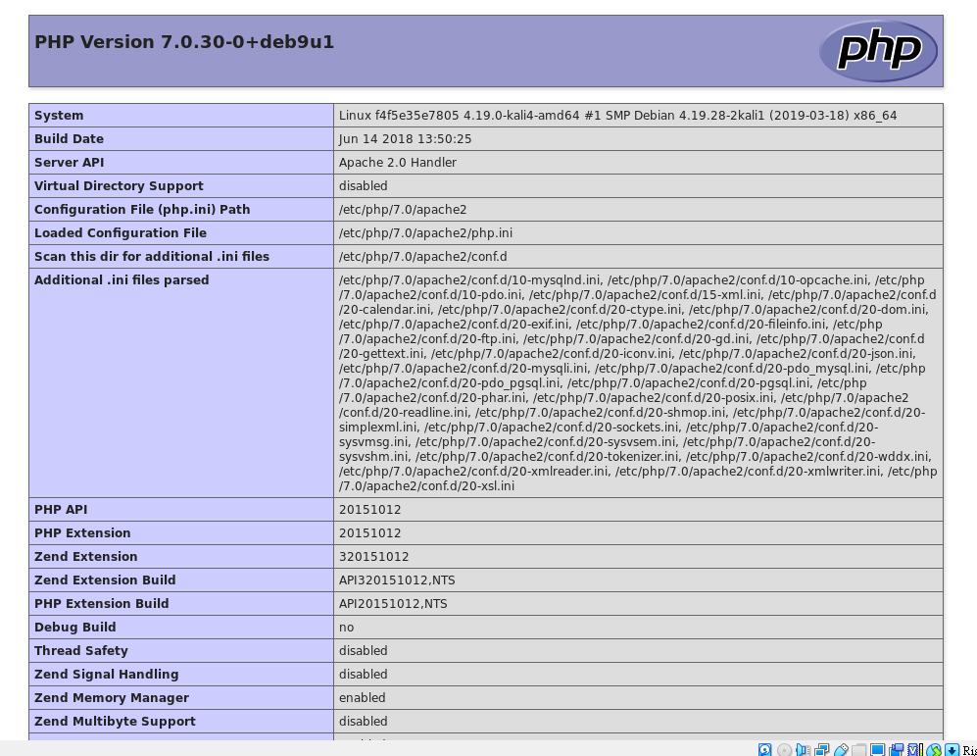
DVWA Security

Slide 9
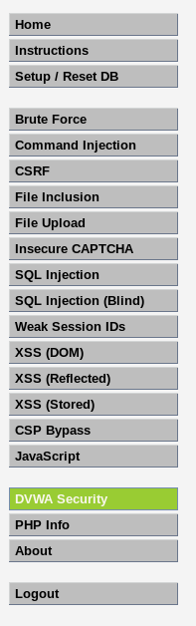
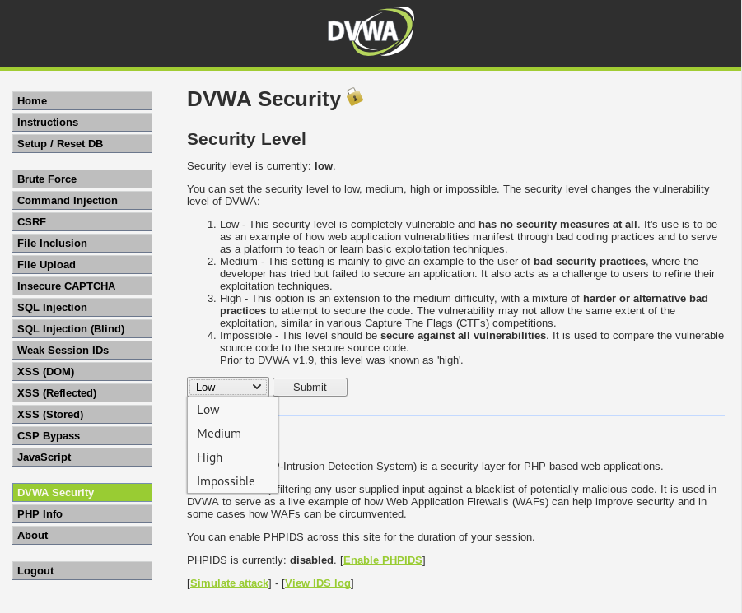
DVWA Security

Slide 10
學習網站應用程式漏洞的分析與實測

Slide 11
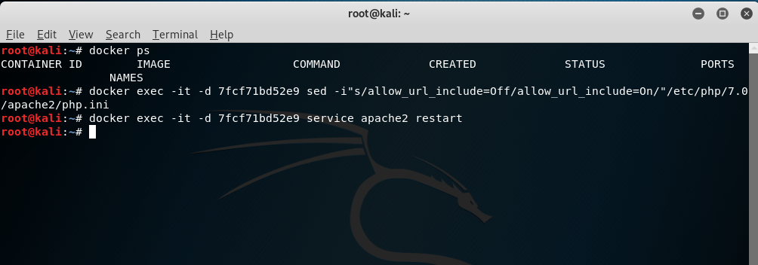
環境建置
docker exec -it -d 7fcf71bd52e9 sed -i"s/allow_url_include=Off/allow_url_include=On/"/etc/php/7.0/apache2/php.ini
docker exec -it -d 7fcf71bd52e9 service apache2 restart

Slide 12
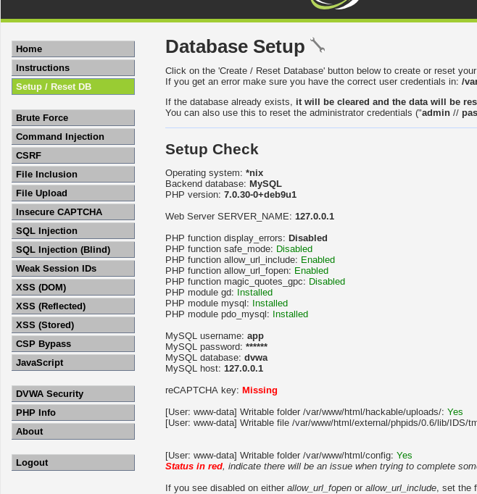

Slide 13
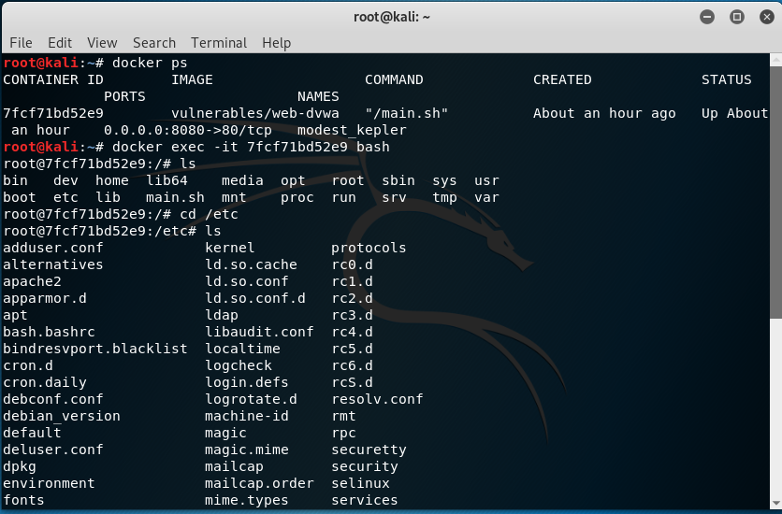
FILE inclusion Vuln:Attack and defense

Slide 14
root@kali:~# docker ps
CONTAINER ID IMAGE COMMAND CREATED STATUS PORTS NAMES
7fcf71bd52e9 vulnerables/web-dvwa "/main.sh" About an hour ago Up About an hour 0.0.0.0:8080->80/tcp modest_kepler
root@kali:~# docker exec -it 7fcf71bd52e9 bash
root@7fcf71bd52e9:/# ls
bin dev home lib64 media opt root sbin sys usr
boot etc lib main.sh mnt proc run srv tmp var
root@7fcf71bd52e9:/# cd /etc
root@7fcf71bd52e9:/etc# ls
/etc/php/7.0/apache2# cat php.ini

Slide 15
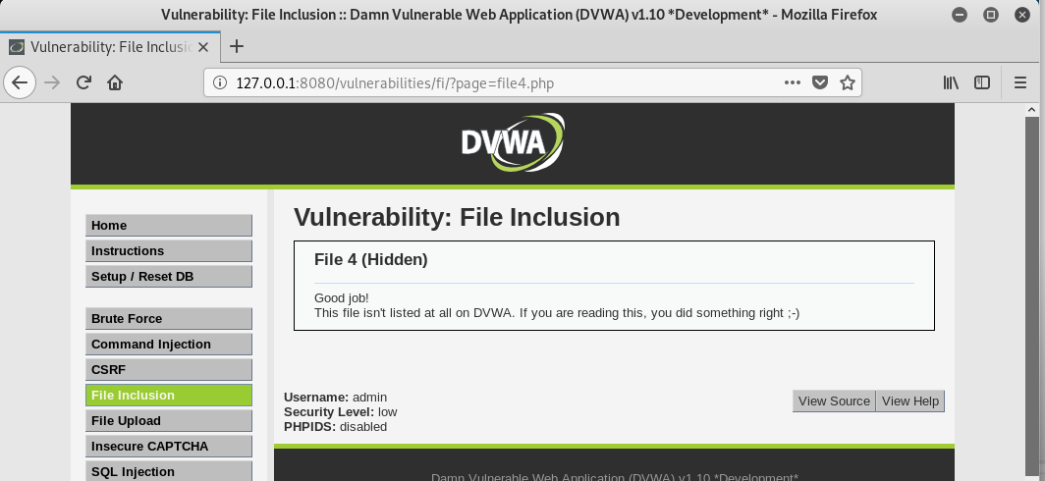

Slide 16
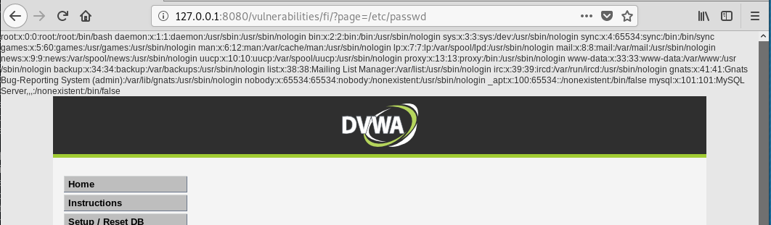

Slide 17
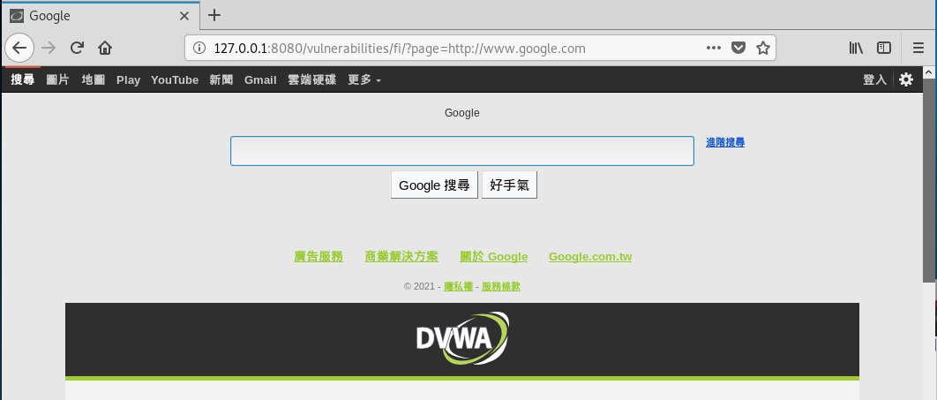

Slide 21
